Slide 1
AI+HW 2035: Shaping the Next Decade
Chen, Cong, Mirhoseini, Kozyrakis, Mitra et al.
arXiv:2603.05225 (March 2026)
Presented by Angela Cui
1
Notes:
10-year vision paper (NSF workshop, 30+ authors)

Slide 2
Motivation
AI scaling is becoming unsustainable
  Training a single frontier model consumes millions of kilowatt-hours
The “memory wall”: energy spent moving data now exceeds energy spent computing, but existing infra is still compute-centric
Hardware and software development are siloed
  Algorithms designed for yesterday’s hardware; chips optimized for today’s workloads
Looking forward:
  Rethink scaling: brute force -> energy-aware, self-optimizing adaptive systems
  Measure success by intelligence / joule, trustworthiness, and adaptability
2
Notes:
Over the past 20 years, peak server hardware FLOPS has been scaling at 3.0x/2yrs, outpacing the growth of DRAM and interconnect bandwidth, which have only scaled at 1.6 and 1.4 times every 2 years, respectively.
energy-aware, self-optimizing, and architecturally adaptive systems.
memory-centric architectures, dense 3D integration, and computein-memory technologies promise to reduce the energy and latency penalties of data movement
AI-in-the-loop hardware design, generative EDA tools, and cross-layer optimization frameworks will enable systems that
learn, adapt, and co-evolve with the algorithms they support.
instead of flops / model size

Slide 3
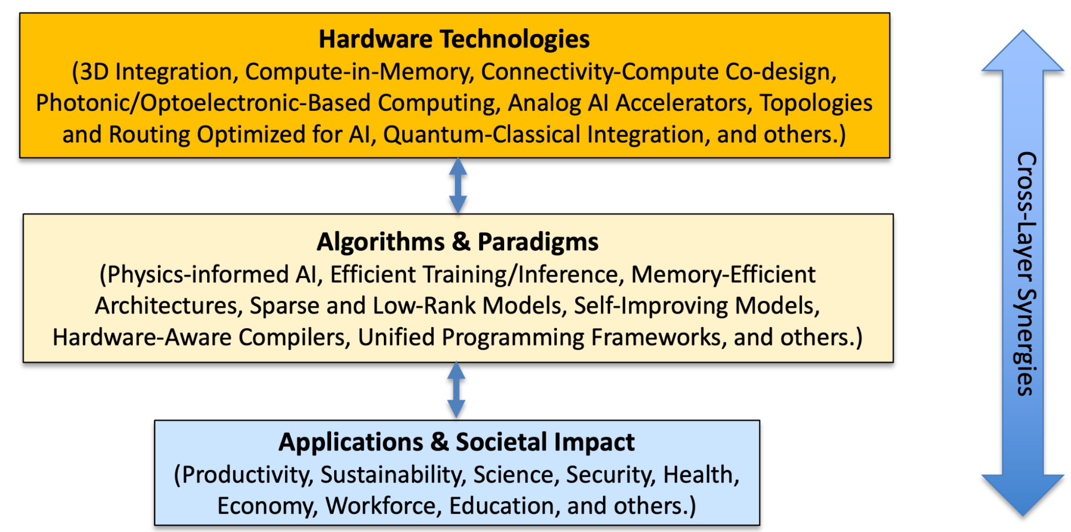
Key Features of Each Abstraction Layer
Key point: these layers form a tightly coupled feedback loop — application needs drive hardware and algorithms, which in turn enable new applications
5

Slide 4
Key Features of Each Abstraction Layer
Hardware Technologies (foundation layer):
Memory-centric architectures, dense 3D integration, compute-in-memory, photonic interconnects, AI-optimized topologies, quantum–classical integration, AI-driven EDA
Algorithms & Paradigms (middle layer):
AI must become hardware-aware; hardware must become AI-adaptive. Embedding AI into the design loop itself. Hardware-aware training (low-precision, sparsity, modularity). Differentiable simulators, neural architecture search, RL-based hardware tuning → self-evolving computing stacks. New learning paradigms: physics-informed AI, latent world models
Applications & Societal Impact (bottom layer):
AI must serve human needs while remaining computationally sustainable. Training a single frontier model could consume energy comparable to entire nations. Domain-specific AI (science, engineering, physical modeling) can drastically reduce compute by embedding physics priors. Edge–cloud hybrid architectures for low-latency reasoning + large-scale training
Key point: these layers form a tightly coupled feedback loop — application needs drive hardware and algorithms, which in turn enable new applications
5

Slide 5
The 1000x Efficiency Target
How do you get three orders of magnitude improvement?
10x from algorithms & model optimization
Sparsity, pruning, quantization, state-space models, hardware-aware training
20x from silicon & hardware advances
3D integration, CIM, photonic interconnects, domain-specific accelerators
5x from system-level efficiency
Fleet optimization, cross-layer scheduling, edge-cloud orchestration
10 × 20 × 5 = 1000x improvement in intelligence per joule
6

Slide 6
Key Insight: The Memory Wall
Data movement is the real bottleneck, not compute
  Energy cost of a DRAM access is ~200x the cost of a floating-point multiply
  Off-chip memory access dominates energy and latency in both training and inference
  Conventional caches poorly match AI access patterns (attention, embedding tables)
Proposed solutions:
  Compute-in-memory: process data where it lives
  3D integration: stack logic, memory, and interconnect vertically
  Photonic interconnects: distance-independent, high-bandwidth communication
7

Slide 7
Key Insight: From Silos to Co-Design
Today (fragmented):
  Algorithms designed for yesterday’s hardware
  Hardware optimized for today’s workloads
  Software stacks tuned for previous-gen chips
  Result: 5–20% real cluster utilization
Vision (co-designed):
  AI-in-the-loop hardware design (generative EDA)
  Hardware-aware model training
  Self-optimizing, reconfigurable architectures
  Cross-layer optimization from materials to applications
8

Slide 8
Hardware: Key Insights & Challenges
Key insights:
  System-level constraints (power, cooling, data movement) now outweigh chip-level compute
  Data movement is the primary bottleneck
  Connectivity is as critical as computation (bandwidth, latency, topology)
  Hardware must become adaptive and reconfigurable, not fixed-function
  AI must help design hardware — closed feedback loop via AI-driven EDA
Key challenges:
  Memory wall: off-chip access dominates energy; caches poorly match AI access patterns
  Connectivity scaling limits: need to codesign network topology with AI dataflow patterns
  Thermal and power delivery constraints
  Design complexity explosion: large design space; simulators and evaluation tools lag behind real-world systems
9
Notes:
The energy cost of moving data across memory hierarchies and interconnects now far exceeds that of arithmetic operations
memory-centric
• Thermal and Power Delivery Constraints (Table 1: Cooling and Power Delivery)◦ Dense 3D stacks exacerbate heat dissipation challenges.◦ Power and thermal limits now directly cap AI performance, scalability, and reliability.◦ Thermal variability introduces reliability and lifetime concerns.

Slide 9
Hardware: Key Questions
Q1: Is hardware still the dominant driver, or have algorithms overtaken it?
Neither alone is sufficient. Sustained progress requires continuous co-evolution.
Q2: Can specialization and generality coexist?
Yes, through hierarchical/modular design (chiplets + analog/photonic components composed via programmable interfaces, compiler support) and algorithmic modularity
Q3: How much approximation can AI systems tolerate?
More than traditional computing assumes. AI workloads are inherently statistical and can tolerate noise, reduced precision, and approximate computation.
Q4: Can hardware design cycles match AI innovation speed?
Not with traditional workflows. AI-in-the-loop EDA and reusable chiplet ecosystems can shorten cycles.
Q5: How should success be measured?
Intelligence per joule, end-to-end latency, scalability — not peak FLOPs.
10

Slide 10
Hardware: Trends & Obstacles
Near-term trends (2–5 years):
  Domain-specific accelerators with native quantization/sparsity
  HBM with tighter coupling to compute; 3D chiplet-based architectures
  Hardware-aware compilers and auto-tuners; edge/on-device AI
Long-term trends (6–10 years):
  Photonic interconnects, compute-in-memory, analog computing at scale
  Dense 3D heterogeneous integration; quantum-classical hybrid systems
  New materials beyond CMOS; ultra-scalable distributed AI systems
Obstacles:
  Noise/drift/calibration in analog and photonic systems
  Yield and reliability in dense 3D integration
  Silent data corruption (SDC) at advanced nodes; fragmented software ecosystems
11
Notes:
Photonic interconnects for
chip-to-chip, on-chip

Slide 11
Hardware: What Success Looks Like
Seamless interoperability across heterogeneous components
  New accelerators integrate without redesigning the entire software stack
Data movement minimized by design
  Connectivity scales transparently; hardware adapts as algorithms evolve
Analog, digital, photonic, and quantum components coexist in unified systems
Hardware platforms can be re-specialized through software and compilation
  New AI models deployed without redesigning silicon — closing the HW–AI speed gap
Systems deliver dramatically higher intelligence per joule
12

Slide 12
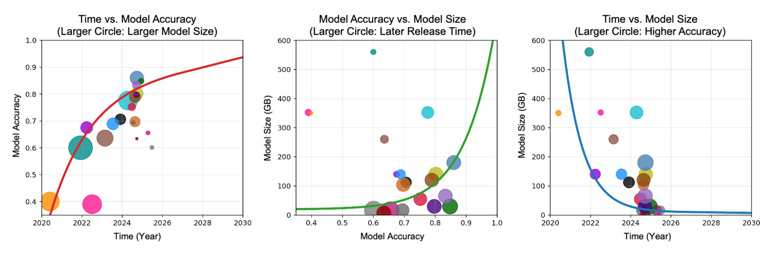
Intelligence efficiency is the new metric
Notes:
First, accuracy improves steadily over time even as model
sizes vary, indicating efficiency gains driven by algorithmic and architectural advances beyond
brute-force scaling. Second, within a fixed time window, higher accuracy generally correlates with
larger model size, reflecting prevailing scaling laws of contemporary foundation models. Third, for
a fixed model size range, accuracy increases over time, highlighting progress in training methods,
data curation, and model design.
no longer focusing on scaling size to get better accuracy, improving all three dimensions

Slide 13
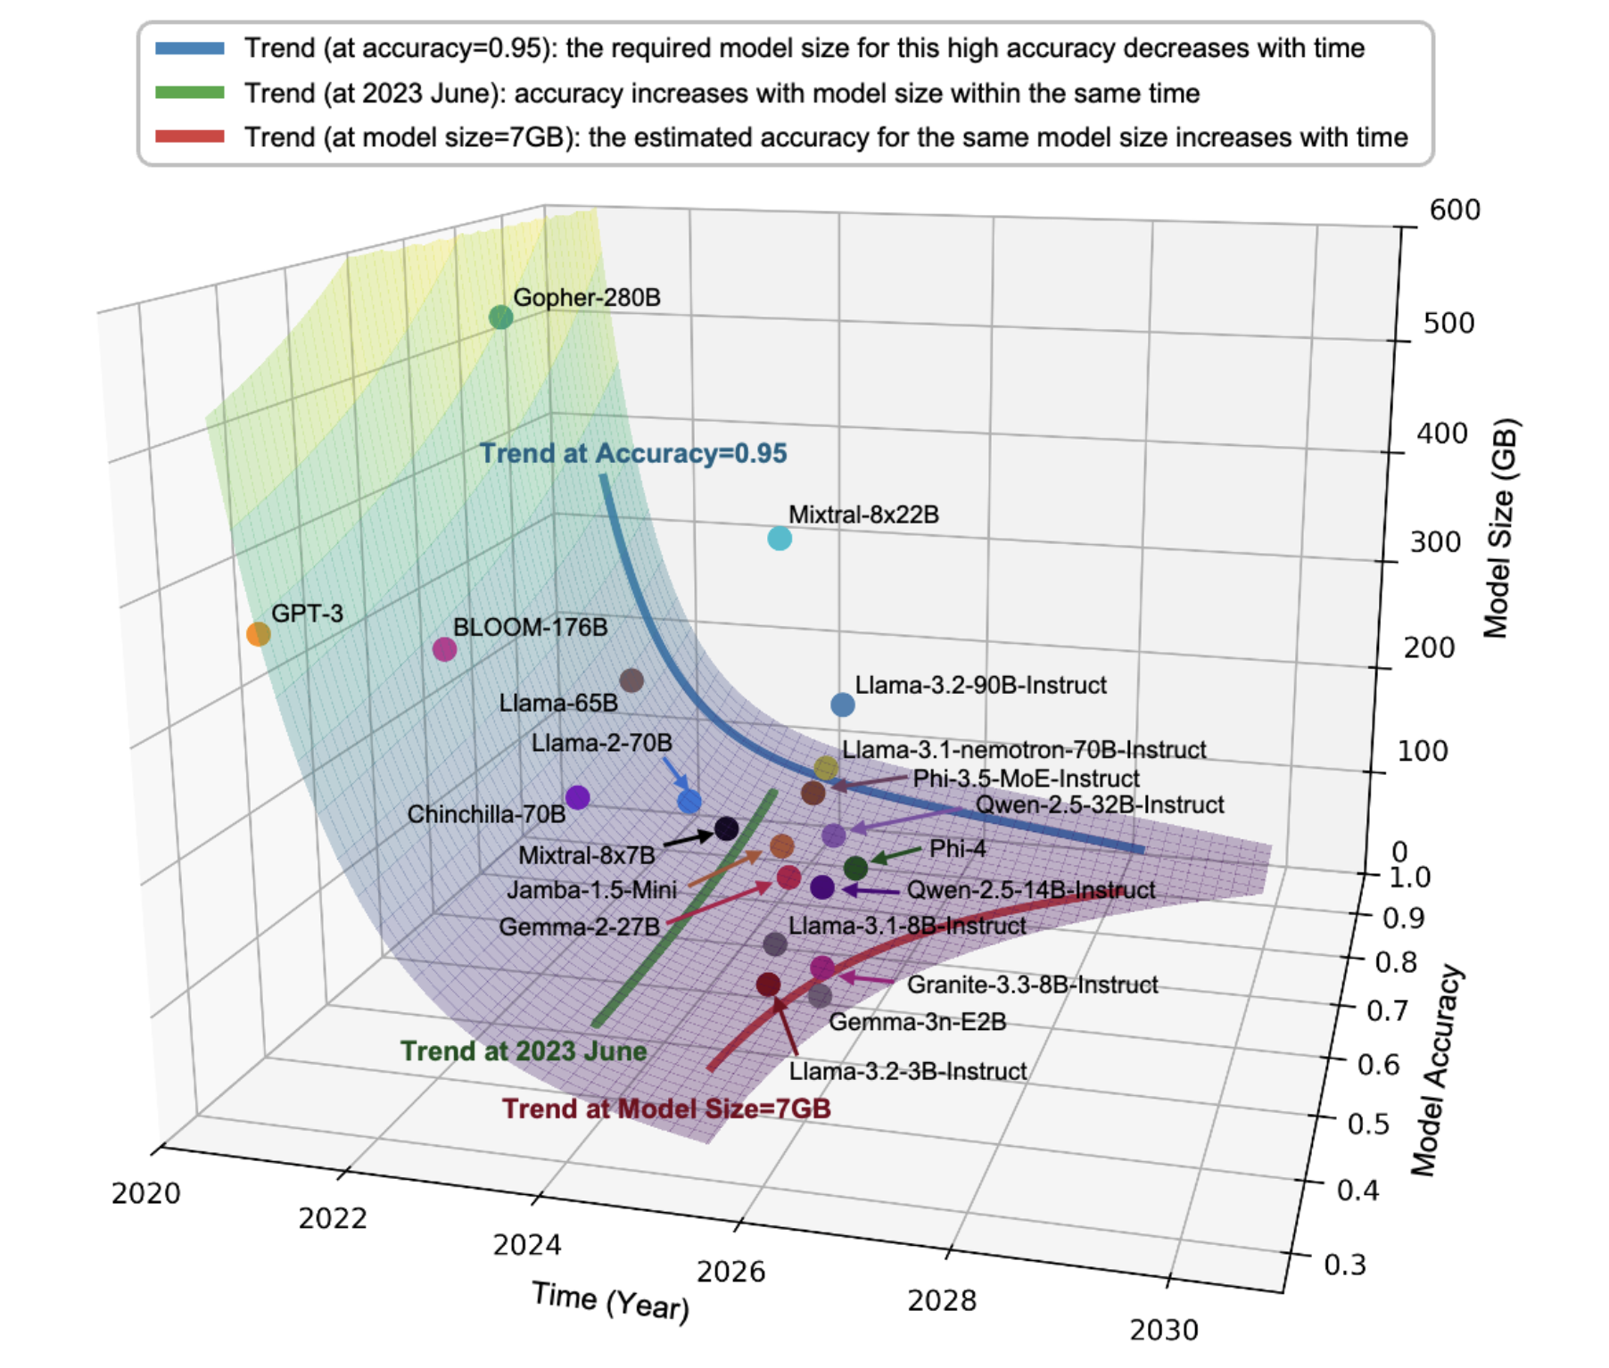

Slide 14
Algorithms: Key Insights & Challenges
Key insights:
  Algorithmic innovation has historically matched or exceeded hardware gains
  Training and inference have fundamentally different system requirements
  Agentic AI systems increasingly act as orchestrators across heterogeneous hardware
Key challenges:
  Siloed HW development and model design, evaluated by narrow metrics
  Brute-force attention + retrieval dominance, inefficient at scale
  Energy, memory, and interconnect walls persist
  Low utilization gap: real clusters run at only 5–20% utilization
  Gigawatt-scale fleet optimization needed, not just per-node gains
13
Notes:
Looking forward, similar breakthroughs are
expected from advances in modular architectures, long-term memory systems, sparsity-aware
learning, causal and physics-informed representations, and agentic decomposition of tasks. These
algorithmic shifts can dramatically reduce computation, memory traffic, and communication
requirements, thereby reshaping hardware design targets rather than merely adapting to them.
Training workloads prioritize throughput, statistical efficiency, peak
accuracy, and amortized energy cost over long time horizons, whereas inference (physical ai systems) demands
millisecond-scale latency, deterministic response, and extreme energy efficiency under tight power
budgets.
Agentic AI systems
increasingly act as orchestrators, selecting models, kernels, hardware resources, and execution
strategies dynamically under real-world constraints
new metrics: memory traffic and data locality instead of FLOPs
Human-like abstraction and alternative model architectures, including ensembles of small
models, can lead to significant efficiency improvements. New learning algorithms are required
to exploit deep memory hierarchies, tiered storage, and persistent memory, shifting optimization
targets from FLOPs to memory traffic and data locality.
overprovisioning?

Slide 15
Algorithms: Key Questions
Q1: What is the bottleneck for scalable AI+HW?
Energy, memory wall, interconnect fabric, underutilized infrastructure, and lack of abstractions.
Q2: Can 10–100x smaller models be equally capable?
Yes, via pruning, quantization, domain-specific distillation, and multi-agent systems where small models selectively invoke larger ones.
Q3: Is attention all we need?
No. Convolutions, SSMs (Mamba), diffusion models all matter. LLM inference is largely memory-bound, not compute-bound. Hardware should boost memory utilization, not just FLOPs.
Q4: What is the ideal hardware architecture?
Heterogeneous, massively parallel, memory-centric systems with 3D stacked memory, optical links, reconfigurable fabrics, and targeted quantum computing.
14

Slide 16
Algorithms: Trends & Obstacles
Future trends:
  Converged heterogeneous stacks: classical + AI-specific + reconfigurable + quantum
  Compute–memory convergence: CIM, 3D stacking, memory-centric dataflow
  Small–big model symbiosis: large teachers, compact small language models on edge via distillation
  Self-optimizing pipelines: models synthesize kernels, schedule themselves
  Decentralized agent-centric AI across edge devices, robots, and digital twins
Obstacles:
  Chicken-and-egg problem across fragmented tech stack layers
  Heterogeneity introduces software burden; brand inertia (“everything is a GPU”)
  Legal/IP barriers for distillation
  Quantum noise and integration complexity
15

Slide 17
Algorithms: What Success Looks Like
Systems that reliably execute complex tasks from human intent (HAI realized)
  Reproducible, multi-metric evaluation: quality, latency, energy, cost, utilization
>100x end-to-end energy efficiency and ≥60% sustained cluster utilization
  From compute–memory integration and closed-loop fleet optimization at GW scale
Fully interoperable heterogeneous systems with optical global links
  CPUs + GPUs + reconfigurable fabrics + ASICs + quantum; memory-centric by default
Mature ecosystem of domain-tuned SLMs distilled from open teachers
Self-improving AI-for-chips pipelines: ≥3x faster silicon design cycles
16

Slide 18
Applications: Key Insights
AI+HW co-design enables fundamentally new classes of applications:
  Agentic AI, autonomous discovery, real-time physical-world interaction
Productivity: smarter design tools, optimized supply chains, resilient manufacturing
Education: AI-powered personalized learning on energy-efficient hardware at scale
Science & health: climate modeling, drug discovery, precision medicine, wearable health
Security: cybersecurity, critical infrastructure protection, national security
Physical AI is the critical test case:
  Systems must operate under strict real-time, safety, energy, and reliability constraints
  End-to-end co-design across models, runtimes, and platforms becomes a prerequisite
17
Notes:
Furthermore, cross-layer AI+HW co-design will be essential for scaling AI into the physical
world, where systems must operate under strict real-time, safety, energy, and reliability constraints.
Unlike purely digital workloads, physical AI applications tightly couple perception, decision-making,
and control with hardware execution, making end-to-end co-design across models, runtimes, and
platforms a prerequisite rather than an optimization.

Slide 19
Applications: Key Questions
Q1: What is the biggest barrier to real-world AI deployment?
Only ~5% of piloted AI technologies achieve sustained financial returns. Barriers: limited continual learning
Q2: What is the most urgent infrastructure challenge?
The impending power crisis. Datacenter demand is rising by tens of GW while U.S. generation lags. China holds a 2x power advantage.
Q3: How can we bridge the academia–industry gap?
University–cloud partnerships, industry-sponsored sustained research programs, and academic incentives that reward practical systems-level contributions.
Q5: Is the 1000x efficiency improvement realistic?
100x in 5 years (high confidence), 1000x in 6–10 years (moderate confidence). Path: 10x algorithms × 20x silicon × 5x systems.
18
Notes:
primarily enhance individual productivity, not P&L performance.

Slide 20
Applications: Trends, Obstacles & Success
Trends:
  Power crisis timeline: U.S. shortages predicted within 5 years
  Cloud-to-edge shift: frontier models → smaller specialized models (<20B) on edge
  AI-driven business models in autonomous vehicles, robotics, agentic AI
Obstacles:
  Infrastructure bottlenecks, fragmented ecosystem, misaligned academic/industry incentives
  Overemphasis on frontier models over efficient edge-centric models
  Talent gaps, validation challenges, Moore’s Law ending
Success in 10 years:
  Power crisis resolved via diversified energy (SMRs, renewables)
  1000x efficiency → redistribution of AI from cloud to edge (robots, AR/VR, vehicles)
  Thriving cross-sector ecosystem; equitable access via open tools and small capable models
  Flourishing AI-driven economy exceeding the Internet’s post-1998 transformation
19

Slide 21
Related Work
1. FlashAttention (Dao et al., NeurIPS 2022)
IO-aware exact attention that minimizes memory reads/writes via tiling and recomputation. Proves the paper’s thesis: algorithmic innovation driven by hardware awareness yields 2–4x speedups without approximation.
2. AI for Chip Placement (Mirhoseini et al., Nature 2021)
Used RL to generate chip floor plans rivaling human experts. Embodies the “AI must help design hardware” closed feedback loop the paper calls essential.
3. Intelligence per Watt (Saad-Falcon et al., 2025)
Proposes concrete metrics for measuring intelligence efficiency—directly operationalizing the shift from FLOPs to “intelligence per joule” as the north-star metric.
20

Slide 22
What Surprised Me
The real bottleneck isn’t compute — it’s plumbing
  We celebrate FLOP counts and parameter scaling, but data movement, memory access, and interconnect energy dwarf arithmetic costs
  The most impactful innovations may look less like clever algorithms and more like clever wiring
The utilization scandal
  We’re spending billions on GPU clusters that run at 5–20% utilization
  That’s not a hardware problem — it’s a systems design failure
The geopolitical dimension
  China generates 2x the electricity of the U.S. If efficiency is equal, raw power becomes a strategic moat — reframes efficiency research as national security
21

Slide 23
Reviews
Strengths noted:
  Cross-layer co-design framework is the core contribution
  Table 1 is a genuinely useful taxonomy (maps technology layers to challenges)
  Candid about obstacles and failure modes (misaligned incentives, legal barriers, etc.)
Criticisms:
  1000x target lacks quantitative justification — why 20x from silicon vs. 10x?
  Repetitive structure (same co-design points recycled across sections)
  Some claims feel speculative (e.g., quantum co-processors by 2035)
  One reviewer flagged AI-generated executive summary as a mistake
  Roadmap is U.S.-centric (NAIRR, NSF funding)
22

Slide 24
Questions
Is the 1000x target realistic?
Will efficiency actually win over raw capability?
Market incentives still reward bigger models. Can intelligence per joule become a real benchmark?
Can hardware design cycles ever match AI innovation speed?
Specialization vs. generality: which wins?
Who actually benefits from this roadmap?
Advanced hardware is concentrated in a few companies. Can this future remain open?
23

Slide 25
Discussion Question 1
If efficiency is so important, why does the market
keep rewarding scale?
GPT-4, Gemini, Claude all competed on capability, not efficiency. Who leads the paradigm shift?
Frontier labs have financial incentives to scale. Efficiency matters more for deployment than for benchmarks.
Counter: the cloud-to-edge shift may force efficiency. Autonomous vehicles, robots, and phones can’t plug into datacenter power.
Does this require government intervention (energy caps, procurement standards) or will the market self-correct?
24

Slide 26
Discussion Question 2
Is cross-layer co-design actually achievable,
or is it a coordination fantasy?
The case for:
  Apple M-series proves vertical integration works
  NVIDIA’s CUDA ecosystem shows software-hardware coupling creates moats
  FlashAttention shows algorithm-hardware awareness yields big wins
The case against:
  Academic incentives reward siloed publications, not cross-layer work
  HW takes years; AI moves monthly. Temporal mismatch persists
  30 authors produced a vision paper, not a prototype
  History: VLIW / Itanium showed co-design can fail spectacularly
25

Slide 27
Discussion Question 3
Who gets left behind in the AI+HW future?
The hardware access gap:
Advanced fabrication is concentrated in 2–3 companies. Can researchers at smaller institutions do meaningful AI+HW work without access to real silicon?
Global power asymmetry:
The roadmap is U.S.-centric. Countries with power advantages but limited semiconductor access face different trade-offs.
The small model promise:
The paper envisions democratization through efficient edge models. But who trains the teacher models? Does distillation concentrate power further?
If you had $10B for AI+HW research, where would you put it?
26

Slide 28
Key Takeaway
The next decade of AI progress will be determined not by who builds the biggest model, but by who builds the smartest system.
This means rethinking every layer of the computing stack — from materials to algorithms — as a single, co-evolving ecosystem.
Efficiency, trustworthiness, and adaptability become first-class design goals.
Thank you! Questions?
27

